Slide 1
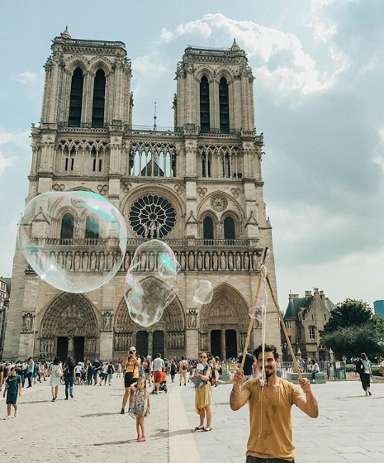


TOURISM
ISABEL BUECHSEL
GRACE CHAN

Slide 2

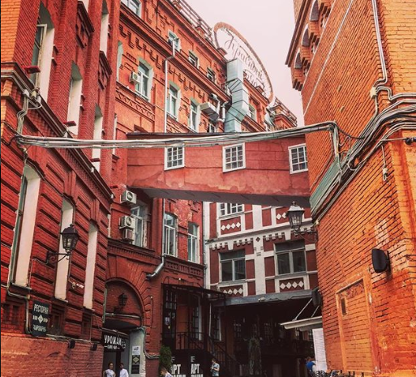
EXPLORING
ARRIVALS
DEPARTURES
TOURISM EXPENDITURE IN COUTRY
TOURISM EXPENDITURE IN OTHER COUNTRY
BY COUNTRY
USING UN DATA

Slide 3


 | 2014
FRANCE | 83.8
USA | 75.0
SPAIN | 65.0
CHINA | 55.6
ITALY | 48.6
HONG KONG | 88.6
RUSSIA | 32.4
UK | 32.6
GERMANY | 33.0
MEXICO | 29.3
TURKEY | 39.8
AUSTRIA | 25.3
CANADA | 16.5
MALAYSIA | 27.4
POLAND | 16.0
2014-FRANCE
83.8 MILLION VISITORS
TOP 15
TOTAL ARRIVALS
1995-2014

Slide 4


 | 2014
HONG KONG | 84.5
USA | 68.3
GERMANY | 83.0
UK | 60.0
POLAND | 66.3
CHINA | 98.2*
RUSSIA | 45.9
ITALY | 28.4
CANADA | 33.5
FRANCE | 28.2
HUNGARY | 21.9
JAPAN | 16.9
NETHERLANDS | 17.9
UKRAINE | 22.4
MALAYSIA | 30.8**
TOP 15
TOTAL DEPARTURES
1995-2014
*2013 DATA FOR CHINA
** 2004 DATA FOR MALAYSIA
Notes:
Hong Kong population – 7.2M
Germany population – 80.1M
China Population – 1.4 Billion
US population 318.6M

Slide 5

TOP 15
TOURISM EXPENDITURE
IN COUNTRY
AUSTRALIA, THAILAND, MACAO, SWITZERLAND, & GREECE WERE NOT IN THE TOP 15 COUNTRIES TRAVELED TO,
HOWEVER, TOURISTS SPENT MORE IN THOSE COUNTRIES
USA
FRANCE
GERMANY
UK
ITALY
AUSTRALIA
THAILAND
SPAIN
HONG KONG
MACAO
CANADA
TURKEY
SWITZERLAND
GREECE
MEXICO
2014-USA
$214.5 BILLION SPENT

Slide 6

TOP 15
TOURISM EXPENDITURE IN OTHER COUNTRY
AUSTRALIA, KOREA, SWITZERLAND, BRAZIL, NORWAY, BELGIUM, AND SAUDI ARABIA WERE NOT IN THE TOP 15 COUNTRIES DEPARTED FROM,
TOURISTS FROM THOSE COUNTRIES SPENT MORE IN OTHER COUNTRIES
USA
GERMANY
UK
JAPAN
FRANCE
CANADA
RUSSIA
AUSTRALIA
KOREA
ITALY
SWITZERLAND
BRAZIL
NORWAY
BELGIUM
SAUDI ARABIA
2014-USA
$145.7 BILLION SPENT
OVERSEAS

Slide 7


1.19 BILLION INTERNATIONAL TOURIST ARRIVALS WORLDWIDE IN 2015
$1.26 TRILLION GLOBAL INTERNATIONAL TOURISM REVENUE IN 2015

Slide 8
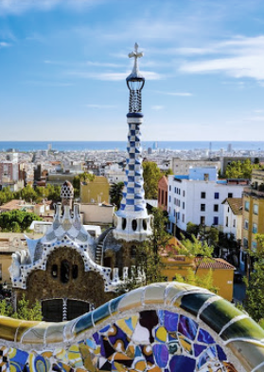

TOP 10 MOST
INSTAGRAMMED CITIES
2017
NEW YORK, US
MOSCOW, RUSSIA
LONDON, UNITED KINGDOM
SAO PAULO, BRAZIL
PARIS, FRANCE
LOS ANGELES, US
ST PETERSBURG, RUSSIA
JAKARTA, INDONESIA
ISTANBUL, TURKEY
BARCELONA, SPAIN

Slide 9
